Slide 1
Forms and Form Controls
Chapter 6

Slide 2
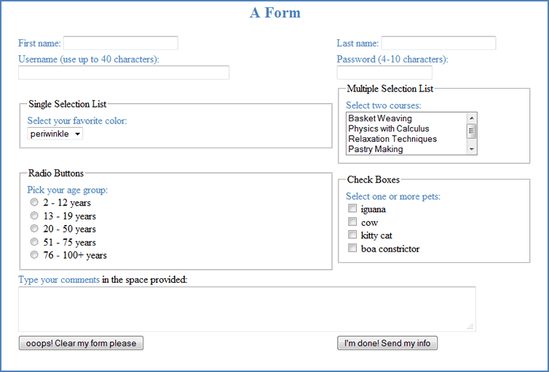
6.1
What is a Form?

Slide 3
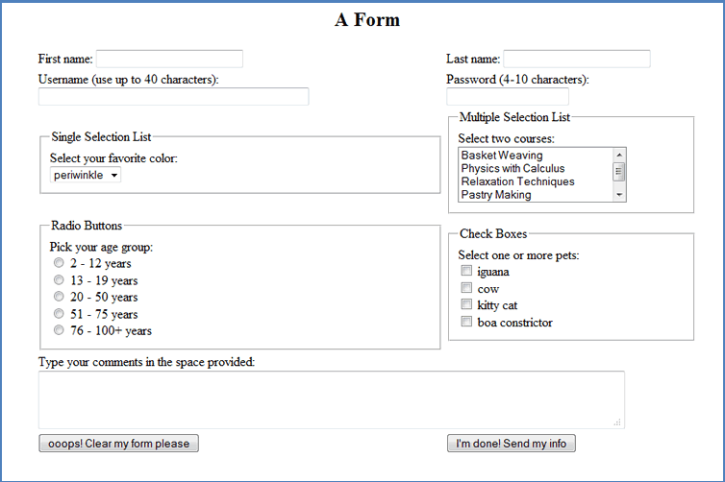
An HTML form is a way to enclose a section of a page with a name and use that name to access the form or the elements in the form, similar to creating a <div></div>. However, the elements in a form are treated differently from other HTML elements.

Slide 4
The <form></form> Tag Pair
A form is an HTML object
The object is created by using an opening <form> tag and a closing </form> tag
Methods, events, attributes, and properties can be used by the form object
The most important is the name
A form is used to collect user input
Without a name, there is no way to access the form and retrieve the input

Slide 5
Creating a Form
<body>
<form name="myfirstform" action="mailto:liz@forms.net"
method="post" enctype="text/plain">
form elements go here
.
.
.
</form>
</body>
name defines the name of this form and will be used to access the information on the form
action returns the value of this attribute
In this form, the action will be to send an email to the following imaginary email address: liz@forms.net
method specifies how to send the results
In this case, results will be sent as an HTTP post transaction
enctype specifies how the data from the form should be encoded before sending it
In this case, the data will use plain text

Slide 6
The submit and reset Buttons
To return data to a server or an email address, a submit button is required.
To clear entries in case a user changes his/her mind, a reset button should be used.
<form name = “myfirstform“ action=“mailto:liz@forms.net”
method=“post“ enctype=“text/plain”>
<h3>The contents of the form would go here</h3>
<input type=“reset” value=“ooops! Clear my form please”>
<input type="submit" value=“I'm done! Send my info”>
</form>
The reset type automatically clears all the user's entries on the form. The submit type automatically submits the user's information using the attributes defined in the <form> tag.

Slide 7
The Common Gateway Interface (CGI)
Common Gateway Interface (CGI): standard method used by web server software
Allows web pages to be generated as executable files called CGI scripts
They are programs usually written in a scripting language.
The server has a folder named cgi-bin at the base of its directory tree and it treats all executable files in that folder as CGI scripts.
To send form data to a script on a web server use this syntax in the opening <form> tag where the script is named data.php:
<form name = "myform" method = "post" id =
"myform" action = "cgi-bin/data.php">
Requires that the programmer has access to a web server

Slide 8
Returning Data by Email
Each submission can also be returned to the developer through an email message.
Simple method, can be used by anyone with an email account
Not ideal – better ways to process large amounts of information
But might work, for example, to process complaints or specific questions from a user to a website
Syntax to send form data by email is, assuming a manager in charge of complaints is named Liz Loverly at liz.loverly@jackiejewels.net:
<form name = "complaints" method = "post" id =
"complaints“ action =
"mailto:liz.loverly@jackiejewels.net">
This method generates an email message to liz.loverly@jackiejewels.net from whatever email program the user employs.

Slide 9

6.2
Form Controls

Slide 10
Radio Buttons
The radio button is an object in an HTML form with properties and events.
The name property defines a group of buttons and thus requires that only one of them can be selected at any time. This distinguishes the radio button from a checkbox.
Property | Description
checked | sets or returns the checked state of the button
defaultChecked | returns the default value of the checked attribute
disabled | sets or returns whether or not the button is disabled
form | returns a reference to the form where the button is
name | sets or returns the name of the button
type | returns the type of the form element
value | sets or returns the value assigned to the button

Slide 11
Checkboxes and Radio Buttons
The checkbox is also an object in an HTML form. It supports the same properties and events as the radio button. However, when the user sees a list of options that are checkboxes, any number of these checkboxes may be selected.
The syntax for each radio button is as follows:
<input type = "radio" name = "radio_button_name" id =
"radio_button_id" value = "radio_button_value">
The syntax for each checkbox is as follows:
<input type="checkbox" name = "box_name" id = "box_id“
value = "box_value">

Slide 12
Textboxes
The textbox is an input element that allows the web developer to display a small area for a user to enter some information.
It has several properties that are not available to radio buttons or checkboxes.
Can set the size of the box (i.e., its width)
Can set the maxlength which configures the maximum number of characters that will be accepted
Can place an initial value in the box, if desired.
The syntax for a textbox is as follows:
<input type="text" name = "box_name" id = "box_id“
size = "20" maxlength = "25" value =
"my box!">

Slide 13
Labels, Fieldsets, Legends
The <label></label> tags allow you to enter a label (a description) for your textbox.
The opening <label> tag goes right before the desired label and the closing </label> tag goes after the label or after the <input> statement.
If a group of form controls are enclosed in <fieldset></fieldset> tags, the browser will put a border around these elements.
Adding the <legend></legend> tags will allow the browser to include a label for the fieldset grouping.

Slide 14
Textarea Boxes
A textarea box designates a space for a user to enter text.
Both height and width can be specified in a textarea box.
textarea tags are <textarea></textarea>
The cols and rows properties determine the size of the box.
These boxes are normally used to allow a web site visitor to include comments or questions when returning a form.
The syntax for a text is as follows:
<textarea name = "box_name" id = "box_id"
cols = "20“ rows = "5">Default
text if desired</textarea>

Slide 15
The email action
The email action is placed in the opening <form> tag
Can also add a subject line to the generated email
Can add a copy to be sent to another recipient.
The syntax for these options are as follows:
This will generate an email sent to whoever@wherever.net with the subject line Whatever:
<form name = "myform" method = "post" enctype =
"text/plain" action =
"mailto:whoever@wherever.net?Whatever">
This will generate an email sent to whoever@wherever.net with the subject line Whatever and will send a copy to whatshisname@whereisit.net:
<form name = "myform" method = "post" enctype =
"text/plain" action = "mailto:whoever@wherever.net
?Whatever&cc=whatshisname@whereisit.net">

Slide 16
6.3
Hidden Fields and Passwords

Slide 17
The Hidden Form Element
Imagine a business website where a customer signs in with his/her username which you want to use on every subsequent page. You can store that username in a hidden field and carry it from page to page.
You can also use the information in a hidden field when you communicate with the server.
Properties of a hidden object are: name, type, id, and value.
The general syntax for a hidden field is as follows:
<input type = "hidden" name = "field_name" id =
"field_id“ value = "field_value" />

Slide 18
The Password Form Element
The password form element is a single-line input field in a form.
The content of the field will be masked (replaced by a character such as an asterisk or small dot).
A password field can be accessed by using document.getElementById().
The general syntax of a password field is as follows:
<input type = "password" then set desired properties />
The password object uses the same properties as the other input fields as well as some others
Property | Description
defaultValue | returns or sets the default value of a password field
disabled | sets or returns whether or not the field is disabled
form | returns a reference to the form where the field is
name | sets or returns the name of the password field
maxLength | sets or returns the maximum number of characters allowed
readOnly | sets or returns whether or not the field is read-only
type | returns the type of the form element
value | sets or returns which type of form element the field is
size | sets or returns the width of the field (i.e., number of characters)

Slide 19
The substr() Method
The substr() method will extract the characters from a string, beginning at the character you specify and continuing through as many characters as you want. It returns the new substring.
String | Character Number
 | 0 | 1 | 2 | 3 | 4 | 5 | ... | n
cat | c | a | t
A table | A |  | t | a | b | l | e
Jones-Smith | J | o | n | e | s | - | ... | h

Slide 20
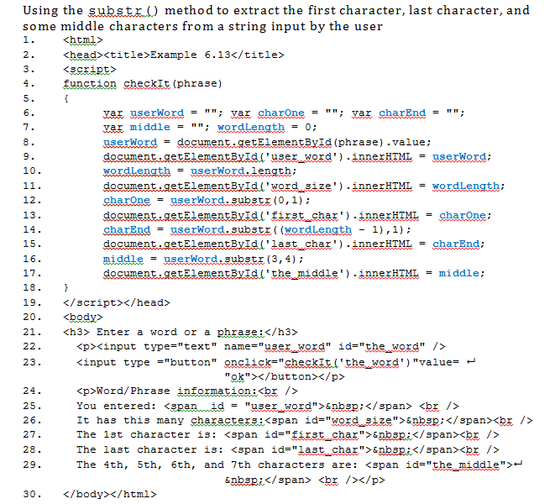

Slide 21
6.4
Selection Lists and More

Slide 22
Selection Lists
A selection list is created using the <select></select> container tags.
Similar to <ul></ul> HTML tags; it defines a container which will house options.
Like <li></li> tags, a selection list configures the items with <option></option> tags.
The general syntax for a selection list, where N is some number is as follows:
<select size = "N" name = "list_name" id = "list_id">
<option value ="option1 value">some text </option>
<option value ="option2 value">some text </option>
......
......
<option value ="optionN value">some text </option>
</select>
The <option> tag can contain the selected property which, when included and set to "selected" will display the value in that tag as highlighted.

Slide 23
The size and multiple Attributes
size shows how many of the options will be visible.
If size is set to 1 a drop-down list will automatically be created to show all the options.
If the size is set to fewer than the number of options, a scroll bar is automatically added to allow the user to see all the options.
When a selection list is created, by default the user is only allowed to select one item.
The multiple attribute allows you to configure a selection box so the user is permitted to select more than one of the options.
Sometimes this attribute may be useful but the user must hold down a particular key to select multiple items so it may be more complicated than it’s worth.

Slide 24
Enhancements for Form Elements
tabindex attribute: The default action for the tab () key is to move to the next form control. This attribute allows you to change the tab order.
accesskey attribute: Allows you to assign a keyboard character as a hot key that user can press to move the cursor immediately to a specific form control. General syntax:
element.accesskey = key_you_choose;
onfocus event: when an element gets focus.
General syntax for use in an HTML document:
<element onfocus = "JavaScript code" >
this keyword: always refers to the function or element that you are referring to.
General syntax of the this keyword is as follows:
<input type="text" name="box_name" id="box_id“ onfocus =  "setFunction(this.id)" />
In this case, the this keyword, combined with .id, identifies the id of this textbox.

